Slide 1
Produced Water Quality Standards & Techno-economic Analysis for Alternative Treatment Trains
September 24, 2021
Interim Results
Nick Tiwari, Chad Able and Tommy Schmitt
NETL support contractors
September 26, 2024
Notes:
SA-2 Activity 9 Task 4-1

Slide 2
Agenda
Objectives
Design Basis
Stream input data
Quality standards
Process Description
Summary of process components
Nanofiltration and membrane distillation unit ops
Results
Future work
QGESS costing module

Slide 3
Objectives
Identify an acceptable water quality standard
Federal drinking water standards
Non-potable reclaimed water standards
Firefighting, irrigation of public parks, agriculture
Propose water treatment trains to purify produced water
Minimum cost and energy expense
Evaluate treatment trains based on cost and effectiveness
Provide recommendations based upon relevant results
Develop additional software tools to improve accuracy and usability
QGESS costing module

Slide 4
Stream input data
With a focus in the Permian Basin, the median data generated in prior work from the National Energy Water Treatment and Speciation database can be reused (critical minerals in bold)
This has additionally been reconciled in OLI Studio (treating boron as B(OH)₃ and Si as SiO₂), producing a final total dissolved solids (TDS) of 99,302 mg/L (the reconciled TDS will be used)
Parameter Name | Median Value
Depth (upper), ft | 6749
Depth (lower), ft | 7408
Depth (well), ft | 7020
Elevation, ft | 2895.5
Temperature, F | 143.45
pH, SU | 6.95
Specific gravity | 1.077
Resistivity, Ohm m | 0.086
Conductivity, μS/cm | 138,000
Parameter Name | Median Value
TDS, mg/L | 101,336
Ammonia, mg/L | 96
Barium, mg/L | 2.355
Boron, mg/L | 19.51
Bicarbonate, mg/L | 231.005
Bromine, mg/L | 224
Calcium, mg/L | 3,127.5
Carbonate, mg/L | 48.885
Chlorides, mg/L | 59,200
Iodine, mg/L | 10
Iron, mg/L | 21
Lithium, mg/L | 10.75
Magnesium, mg/L | 889.115
Manganese, mg/L | 0.885
Potassium, mg/L | 402.87
Silicon, mg/L | 12
Sodium, mg/L | 31,275
Strontium, mg/L | 123.755
Sulfate, mg/L | 1,438.375

Slide 5
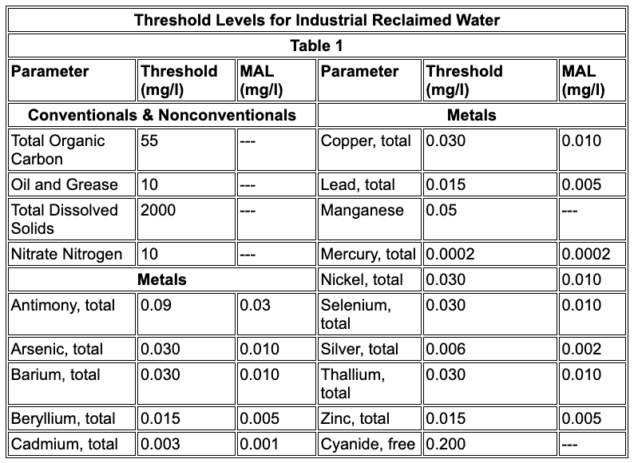
Water quality standards
Federal drinking water standards
Level I reclaimed water, according to the Texas Administrative Code §210.53

Slide 6
Process description
Pretreatment
Primary Treatment
Secondary Treatment
Influent
Ion Exchange (IX)
Nanofiltration (NF)
Membrane Distillation (MD)
Low salt rejection reverse osmosis (LSRRO)
Osmotically Assisted Reverse Osmosis (OARO)
Crystallization
Effluent

Slide 7
Process description
Pretreatment
Primary Treatment
Secondary Treatment
Influent
Ion Exchange (IX)
Nanofiltration (NF)
Membrane Distillation (MD)
Low salt rejection reverse osmosis (LSRRO)
Osmotically Assisted Reverse Osmosis (OARO)
Crystallization
Effluent

Slide 8
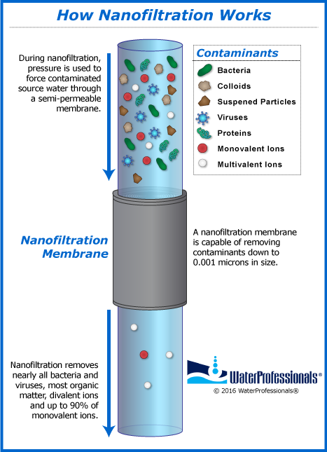
Nanofiltration (NF)
Driven by hydrostatic pressure difference
Capable of filtering particles 1-10 Å in size
WaterTAP model
Assumed performance model
Donnan Steric Pore Model (DSPM)
Water professionals. WaterProfessionals®. (n.d.). https://www.waterprofessionals.com/learning-center/nanofiltration/

Slide 9
Nanofiltration – assumed performance model
Performance is based on the user’s specification, not on physics/thermodynamics
2 DOF
Mass fraction of components in inlet feed (x_{f,i})
Mass fraction of solute rejected by membrane (x_{r,i})
Pros
Easy to set up
Quick to simulate
Highly flexible
Cons
Lack of physical basis makes potential for error much higher
Related process parameters aren’t affected by change in performance variable
Reject
Permeate
Feed

Slide 10
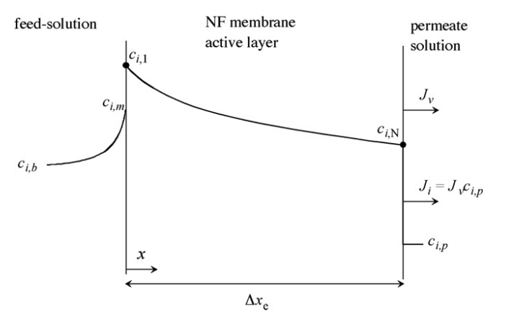
Donnan Steric Pore Model
Based on Nernst-Planck equations
NP describes mass transport of a charged species in fluid
Pros
Underlying physics describe performance
Cons
Requires more time to solve than assumed performance
We’re solving a non-linear ordinary differential equation (finite-difference method)
Geraldes, V., & Brites Alves, A. M. (2008). Computer Program for simulation of mass transport in nanofiltration membranes. Journal of Membrane Science, 321(2), 172–182. https://doi.org/10.1016/j.memsci.2008.04.054

Slide 11
Donnan Steric Pore Model
J_{i} | Solute flux | c_{i} | Ion concentration
J_{v} | Permeate volume flux | z_{i} | Ion valence
D_{i,p} | Hindered diffusion coefficient | RT | Thermal energy
K_{i,c} | Convection hindrance coefficient | ψ | Electrostatic potential
F | Faraday constant
Diffusion
Advection
Electromigration
Geraldes, V., & Brites Alves, A. M. (2008). Computer Program for simulation of mass transport in nanofiltration membranes. Journal of Membrane Science, 321(2), 172–182. https://doi.org/10.1016/j.memsci.2008.04.054

Slide 12
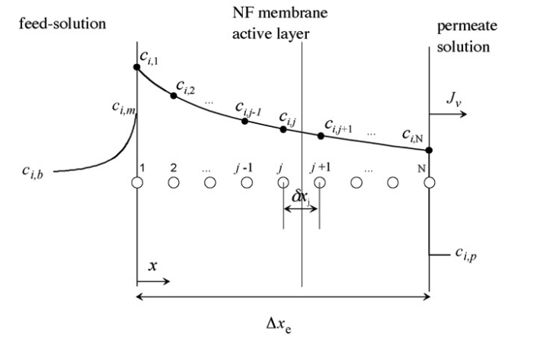
Donnan Steric Pore Model
J_{i} | Solute flux | c_{i} | Ion concentration
J_{v} | Permeate volume flux | z_{i} | Ion valence
D_{i,p} | Hindered diffusion coefficient | RT | Thermal energy
K_{i,c} | Convection hindrance coefficient | ψ | Electrostatic potential
F | Faraday constant
Diffusion
Advection
Electromigration
Discretization
Geraldes, V., & Brites Alves, A. M. (2008). Computer Program for simulation of mass transport in nanofiltration membranes. Journal of Membrane Science, 321(2), 172–182. https://doi.org/10.1016/j.memsci.2008.04.054

Slide 13
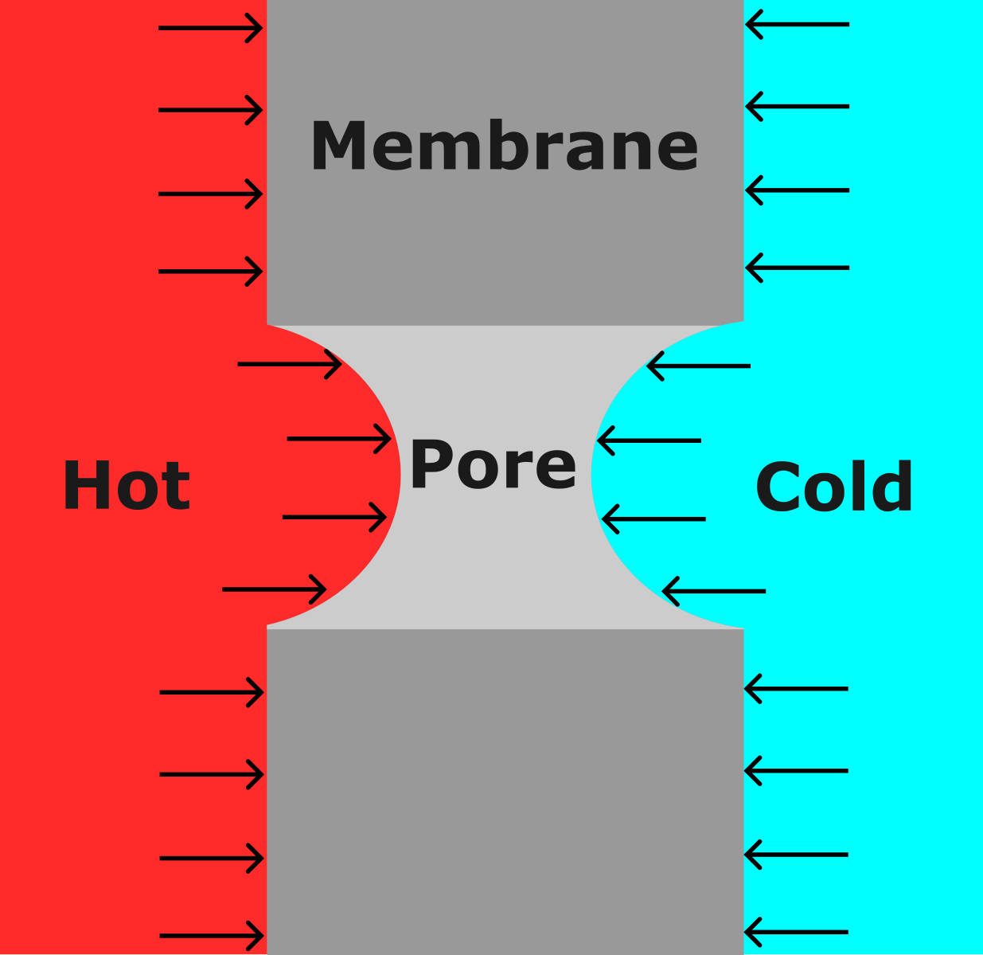
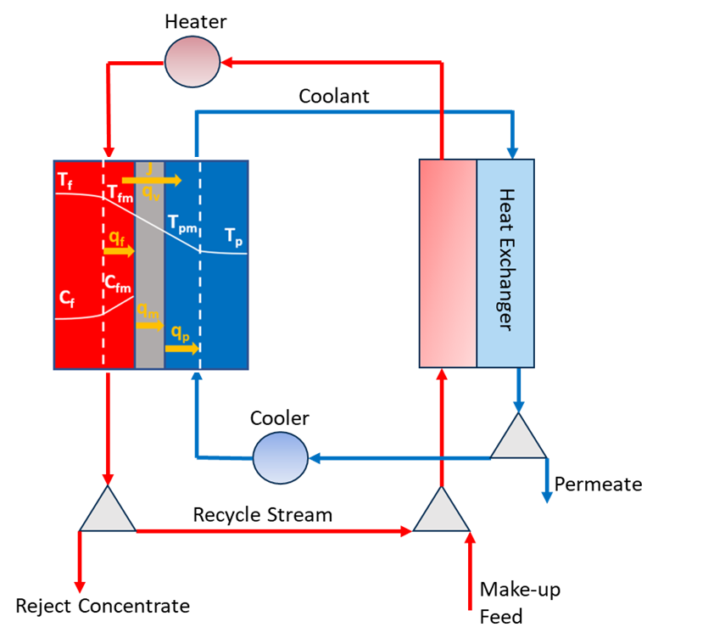
Membrane distillation (MD)
Membrane is hydrophobic
Water contact angle > 90°
Liquid cannot pass through pores
Any water that is present is in the vapor phase
Vapor pressure of metals/salts at normal operating conditions (below several hundred Celcius) is extremely low
Almost no solute should pass through
Vapor pressure difference arises due to temperature change
This is the driving force
Notes:
The standards may be more about temperature, pressure, etc. rather than the value of specific constituents. Assuming there are no standards for those applications, the analysis would default to federal drinking water standards.

Slide 14
Membrane distillation (MD) – WaterTAP process model
Process components
Heater
Cooler
Heat Exchanger
MD unit
Total process cost incorporates individual costs for all process components
Notes:
The standards may be more about temperature, pressure, etc. rather than the value of specific constituents. Assuming there are no standards for those applications, the analysis would default to federal drinking water standards.

Slide 15
Results

Slide 16
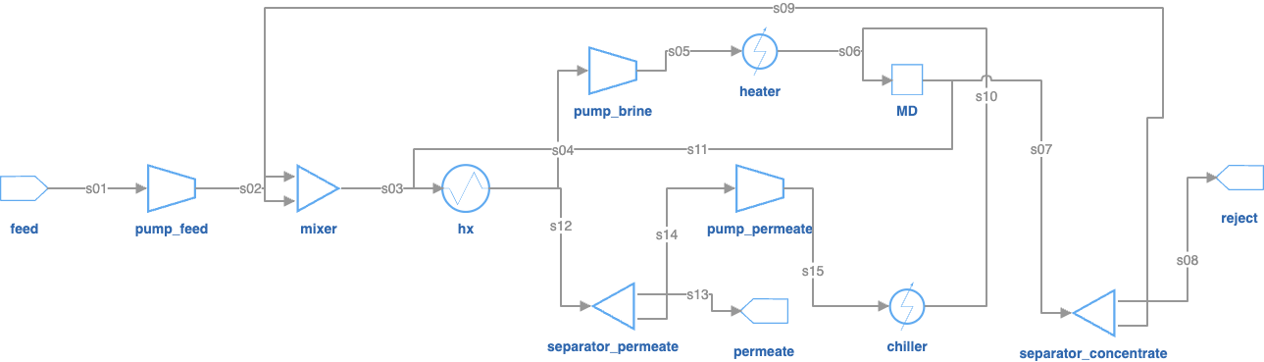
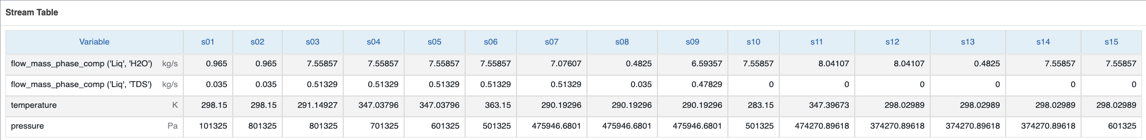
A sample flowsheet/stream table

Slide 17
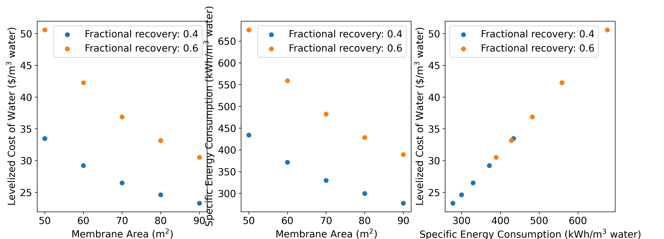
Normalized water cost and energy consumption

Slide 18
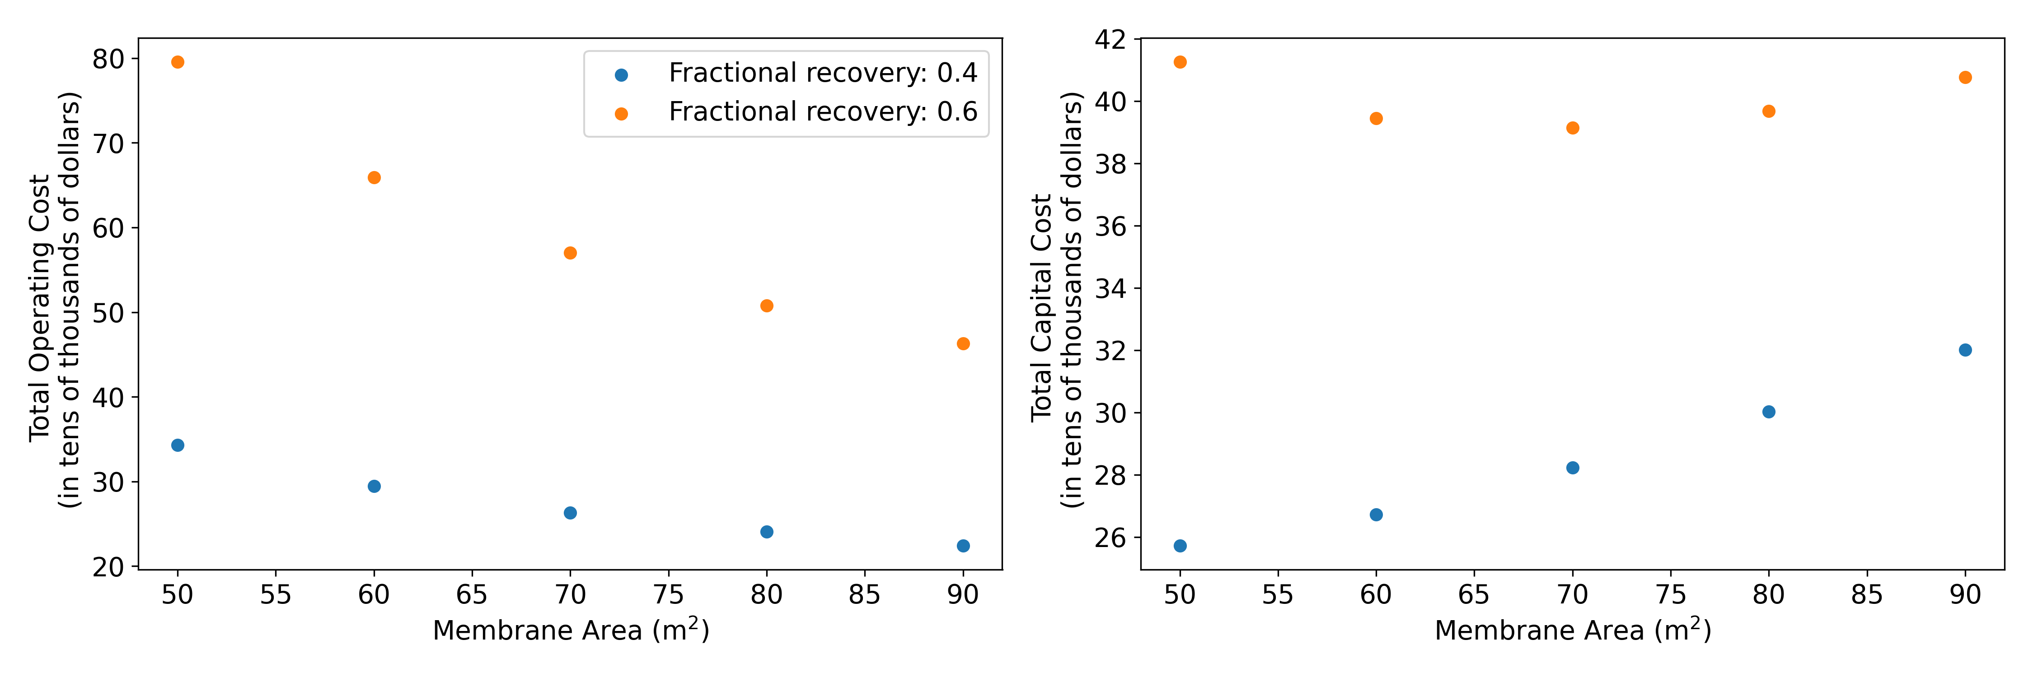
Total operating and capital cost
LCOW is generally dominated by operating costs, not capital costs
Utility requirements (e.g. heating and cooling duty)

Slide 19
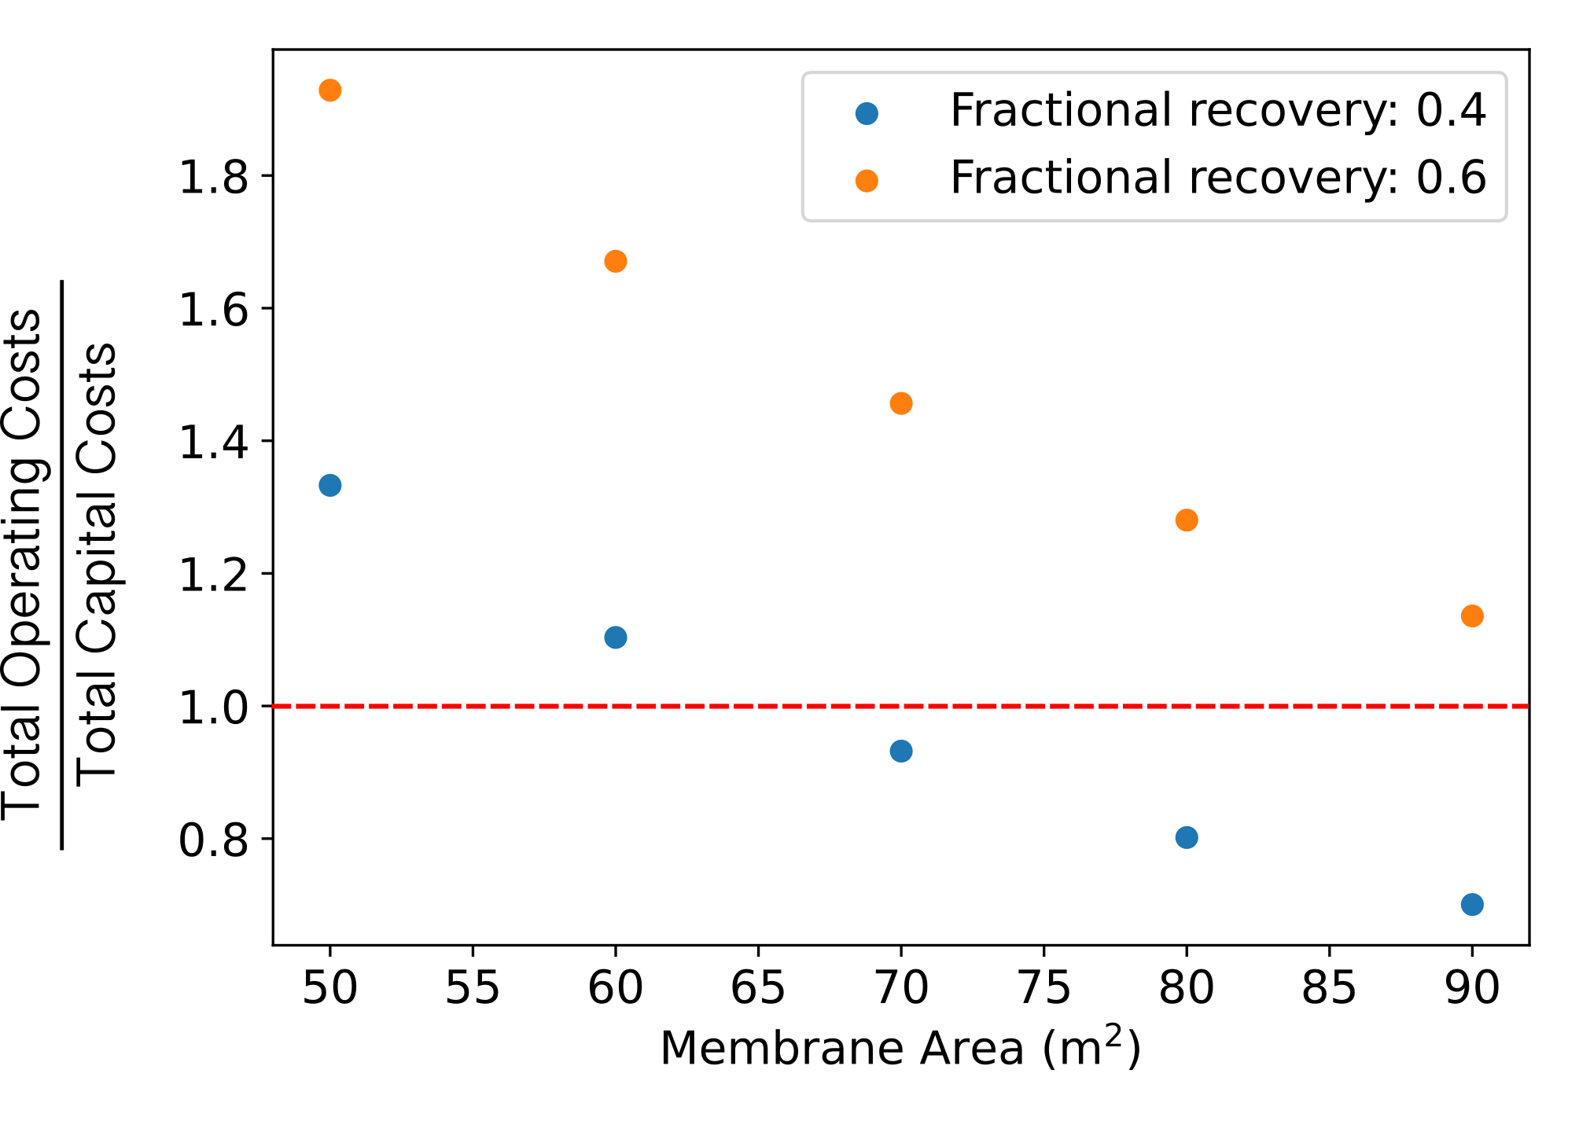
TOC relative to TCC
TOC exceeds TCC only for:
Low fractional recovery
High membrane area
This is reasonable given that large membranes should be both more expensive and better at purification

Slide 20
Future work

Slide 21
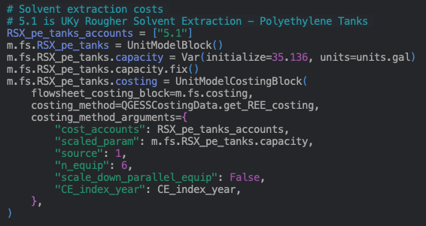
QGESS costing implementation
WaterTAP has a dedicated costing method
Very simple – often just sizes equipment based on a single parameter (i.e. membrane size)
Through modification of the QGESS costing class provided in PrOMMIS, we can add this functionality to
Assumed QGESS costing parameters
Scaling parameter

Slide 22


Questions/ Comments
Alison Fritz
Alison.Fritz@netl.doe.gov
Notes:
Photo: 3-D printing of NETL logo in the Multiphase Flow Analysis Laboratory at NETL Morgantown

